Slide 1

Artificial Intelligence (Machine Learning & Deep Learning) - [Course]
It is not about Theory, it is 20% Theory and 80% Practical –Technical/Development/Programming [Mostly Python based]
By the end of this course, the trainees should gain the following competencies:
Understanding of core concepts of artificial intelligence and machine learning
State of the art machine learning techniques
Hands-on exposure to exploratory data analysis Practical exposure to model design, evaluation
Familiarity with tools and libraries such as numpy, pandas, scikit learn, tensorflow, and keras
About Instructor:
Shahzad - Software Fractional Strategy Consultant - 25+ Years of Experience in Software Industry - with clients in across North America and Europe, with focus on:
Cloud/SaaS- Software as Service
Artificial Intelligence & Generative AI & LLM
Machine Learning & Deep learning & Neural Networks
Data Analytics, Business Intelligence and Data Science
CRM-ERP-CMS – Development, Implementation and Consulting
Ecommerce Development - Platform and Services
About Institute: NexSkill is Pakistan's leading IT training institute, providing the best IT training in Pakistan. NexSkill offers a variety of professional learning platforms to its students.
https://www.nexskill.com/

Slide 2
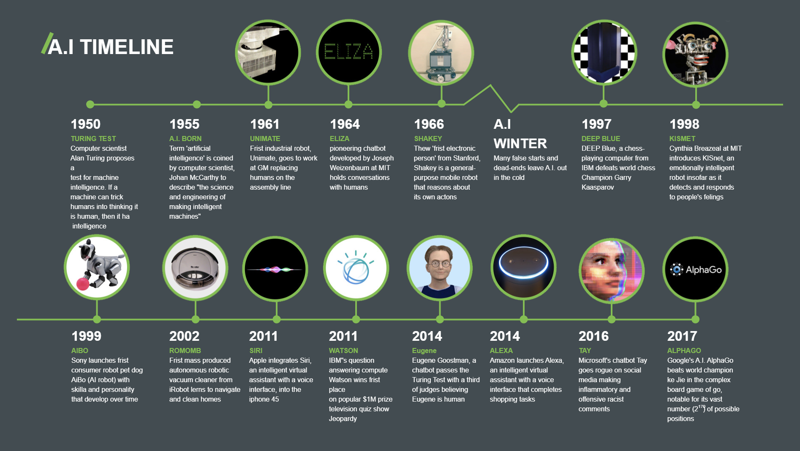
Artificial Intelligence (Machine Learning & Deep Learning) -Timelines

Slide 3
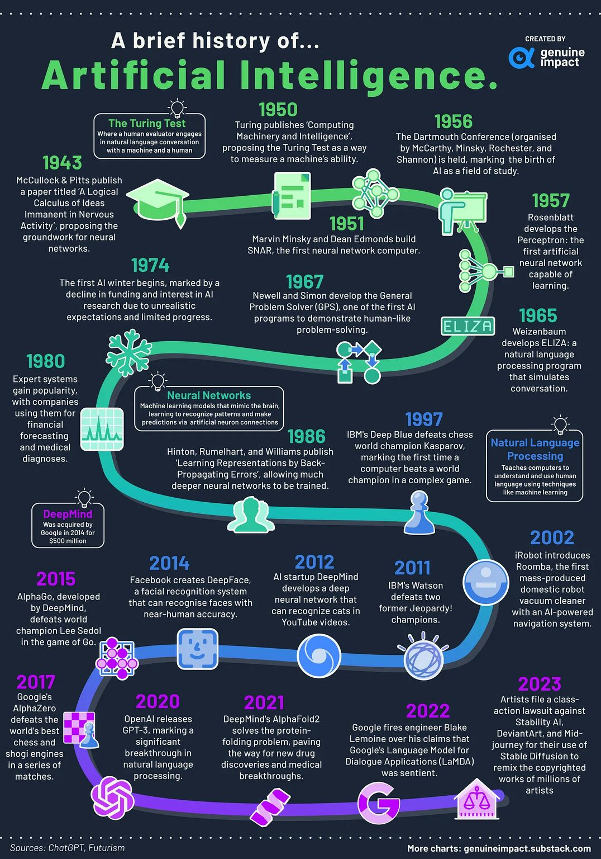
Artificial Intelligence
(Machine Learning & Deep Learning) –
Timelines – 2nd View

Slide 4

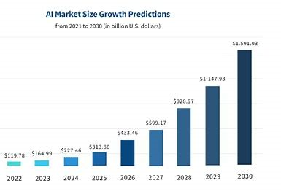
Why AI is so important Today-What is happening
-----------------------------
Importance Of AI – Every CMS/CRM/ERP/E-commerce - solution , Every product or Every Mobile App or Every web app
Applied AI in Industry:
Exercise: Create a account for HubSpot – explore breeze / co-pilot features
https://www.hubspot.com/products/artificial-intelligence
Exercise: Create a account for Microsoft 365 – explore co-pilot features
https://www.microsoft.com/en-us/microsoft-365/copilot
Market Growth: The global AI software market is expected to continue its rapid growth. According to various market research reports, the AI software market was valued at approximately $136.55 billion in 2023 and is expected to grow at a compound annual growth rate (CAGR) of around 37-40% from 2024 to 2030. This would bring the market size to over
$1 trillion by 2030. [ Source: Statista - https://www.statista.com ]
Development Team formation : Old style Formation vs New style Formation
2 front end developer + 2 backend developer + 1 QA engineer + Team Lead [Old style Formation ]
2 front end developer + 2 backend developer + 2 AI/ML Engineer + 1 QA engineer + Team Lead [New style Formation ]
-------------------
StarGate Initiative: The Stargate Project is a new company which intends to invest $500 billion over the next four years - initial equity funders in Stargate are SoftBank, OpenAI, Oracle, and MGX
https://openai.com/index/announcing-the-stargate-project/
https://fortune.com/2025/01/22/what-is-the-stargate-ai-project-trump-ellison-son-altman/
https://www.forbes.com/sites/emilsayegh/2025/01/22/stargate-ai-project-the-500-billion-gamble-to-dominate-the-future/

Slide 5
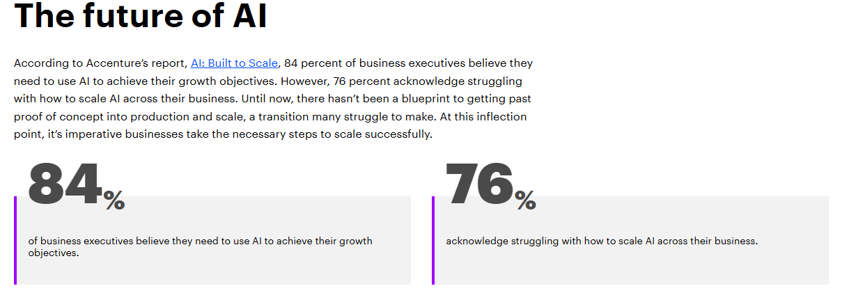

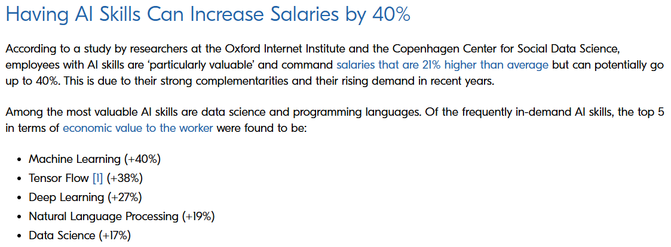




Which skills are in demand
https://www.berlin-international.de/en/magazine/blog/why-having-ai-skills-is-important-in-todays-business-world/
https://www.forbes.com/sites/rachelwells/2024/06/10/3-in-demand-high-income-ai-skills-you-need-in-2024/
https://www.coursera.org/in/articles/ai-skills
AI Career Professional and Industry Trends
Accenture - Reference: https://www.accenture.com/cz-en/insights/consulting/gen-ai-reinventing-enterprise-models
https://www.accenture.com/cz-en/insights/artificial-intelligence-summary-index
Dynamics of AI Power economy and ecosystems - Reference:
https://onlinedegrees.sandiego.edu/ai-impact-on-job-market/
https://www.forbes.com/councils/forbestechcouncil/2025/01/10/how-artificial-intelligence-is-transforming-the-job-market-a-guide-to-adaptation-and-career-transformation/
https://mhrc.lums.edu.pk/how-susceptible-pakistans-job-market-ai
https://www.iedconline.org/clientuploads/EDRP%20Logos/AI_Impact_on_Labor_Markets.pdf

Slide 6

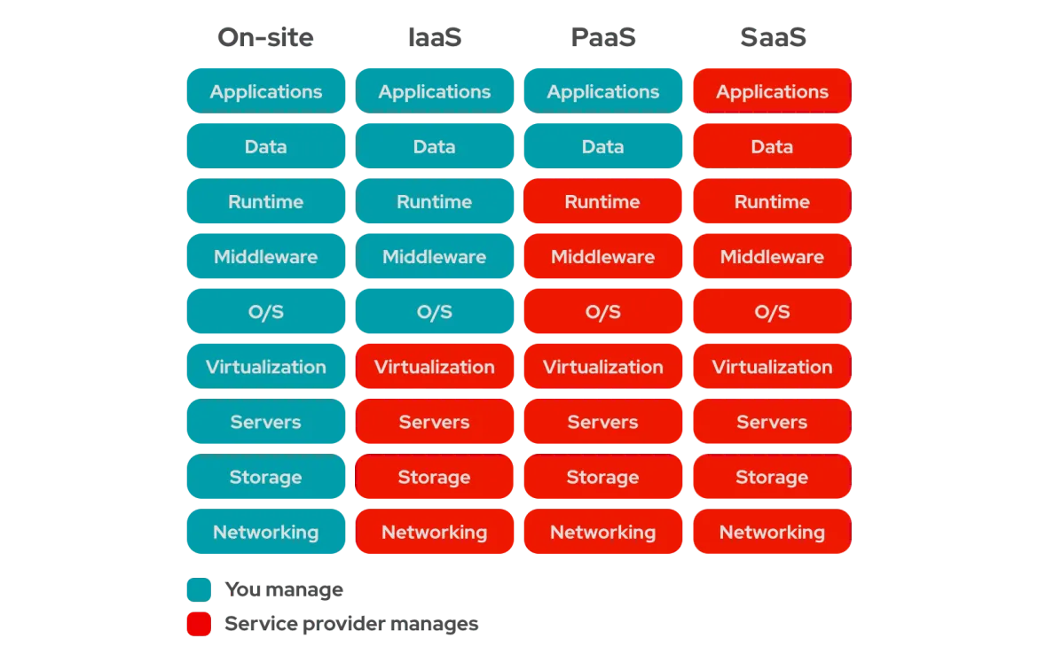
Modern SaaS AI Development Services
SaaS AI Development Platform : MicroSoft vs Google vs Amazon vs Oracle vs IBM
Microsoft – Azure AI Services:
https://azure.microsoft.com/en-us/solutions/ai/
Google AI services:
https://cloud.google.com/products/ai/
Amazon AI Services
https://aws.amazon.com/ai/services/
Oracle AI Services:
https://www.oracle.com/artificial-intelligence/ai-services/
IBM AI Services:
https://www.ibm.com/artificial-intelligence
Azure AI services – are included with training tasks.
References:
https://www.redhat.com/en/topics/cloud-computing/iaas-vs-paas-vs-saas
https://www.bmc.com/blogs/saas-vs-paas-vs-iaas-whats-the-difference-and-how-to-choose/

Slide 7
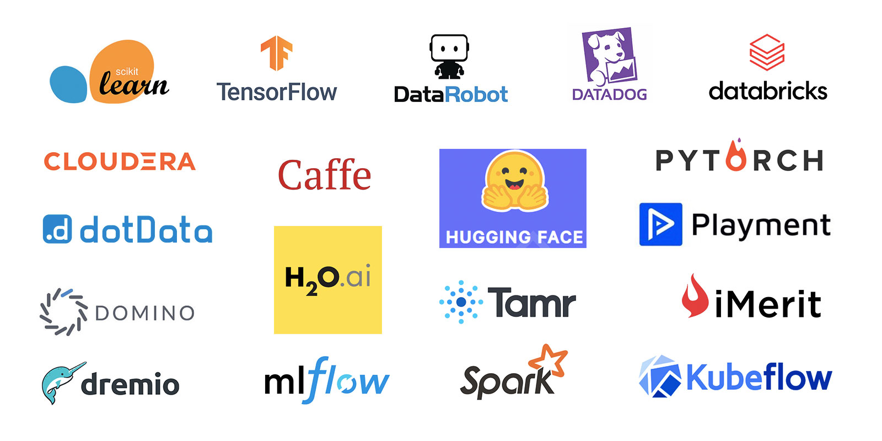
AI Standard alone Development Services,
Platform, Framework
References:
https://dagshub.com/blog/top-ai-frameworks-and-libraries/
https://www.splunk.com/en_us/blog/learn/ai-frameworks.html
https://www.geeksforgeeks.org/top-artificial-intelligence-frameworks/
https://5ly.co/blog/best-ai-frameworks/
https://clockwise.software/blog/artificial-intelligence-framework/

Slide 8
AI/ML/DL–Framework/Services[Covered in this Course]
Scikit-learn
Simple and efficient tools for predictive data analysis
Accessible to everybody, and reusable in various contexts
https://scikit-learn.org
TensorFlow
An end-to-end platform for machine learning
TensorFlow makes it easy to create ML models that can run in any
environment.
https://www.tensorflow.org/
Keras
Keras is a deep learning API designed for human beings, not machines. Keras
focuses on debugging speed, code elegance & conciseness, maintainability,
and deployability
https://keras.io/

Slide 9
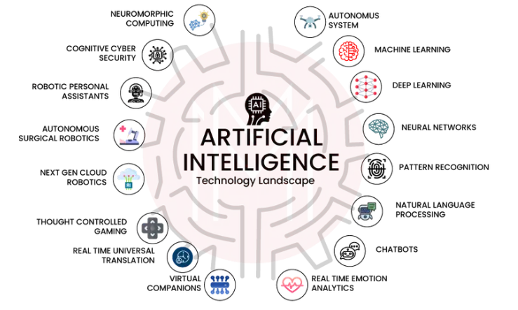
Basics - What is AI-Artificial Intelligence
Artificial intelligence (AI), the ability of a digital computer or computer-controlled robot to perform tasks commonly associated with intelligent beings. The term is frequently applied to the project of developing systems endowed with the intellectual processes characteristic of humans, such as the ability to reason, discover meaning, generalize, or learn from past experience
References:
https://cloud.google.com/learn/what-is-artificial-intelligence?hl=en
https://www.coursera.org/articles/what-is-artificial-intelligence
https://www.ibm.com/think/topics/artificial-intelligence

Slide 10
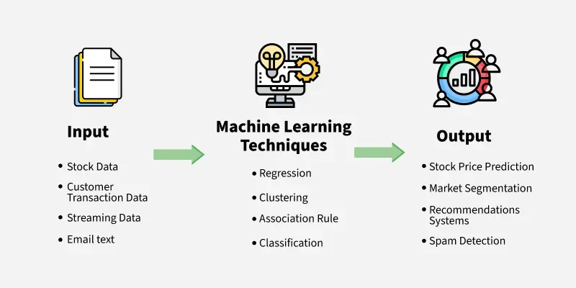
Basics - What is ML-Machine Learning
Machine Learning (ML) is a subset of Artificial Intelligence (AI) that enables computers to learn and improve from data without explicit programming, using algorithms to analyze data, identify patterns, and make predictions or decisions
References:
https://www.ibm.com/think/topics/machine-learning
https://www.spiceworks.com/tech/artificial-intelligence/articles/what-is-ml/
https://cloud.google.com/learn/artificial-intelligence-vs-machine-learning?hl=en

Slide 11
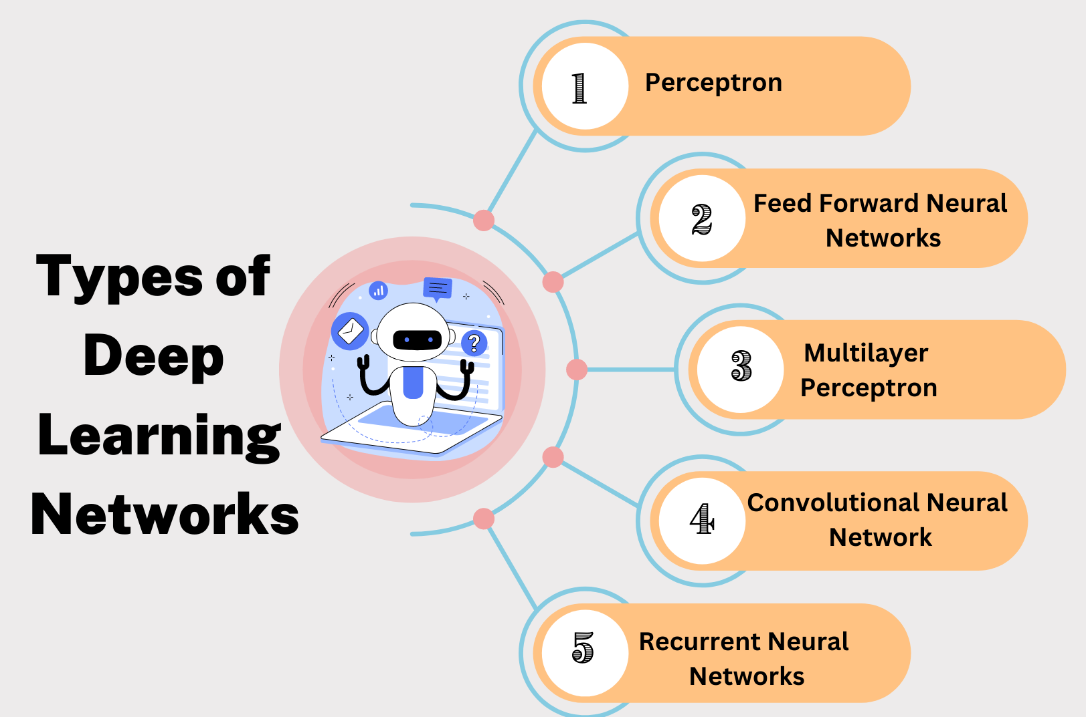
Basics - What is DL-Deep Learning
Deep learning is a subset of machine learning that focuses on utilizing neural networks to perform tasks such as classification, regression, and representation learning.
References:
https://aws.amazon.com/what-is/deep-learning/
https://www.ibm.com/think/topics/deep-learning
https://cloud.google.com/discover/what-is-deep-learning?hl=en

Slide 12
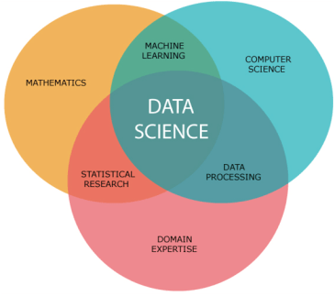
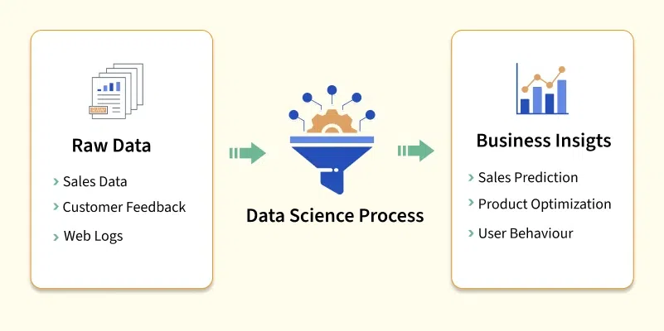
Basics – What is Data science
References:
https://medium.com/analytics-vidhya/introduction-to-data-science-28deb32878e7
https://www.ibm.com/think/topics/data-science
https://www.geeksforgeeks.org/data-science/
https://ischoolonline.berkeley.edu/data-science/what-is-data-science/
https://www.datacamp.com/blog/what-is-data-science-the-definitive-guide

Slide 13
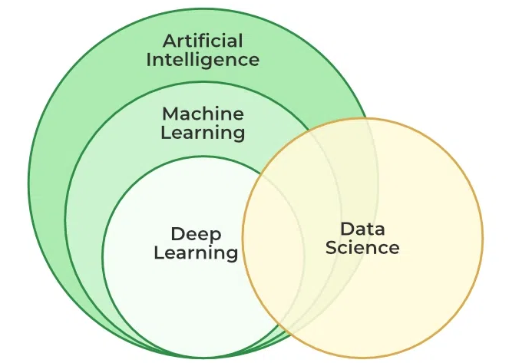
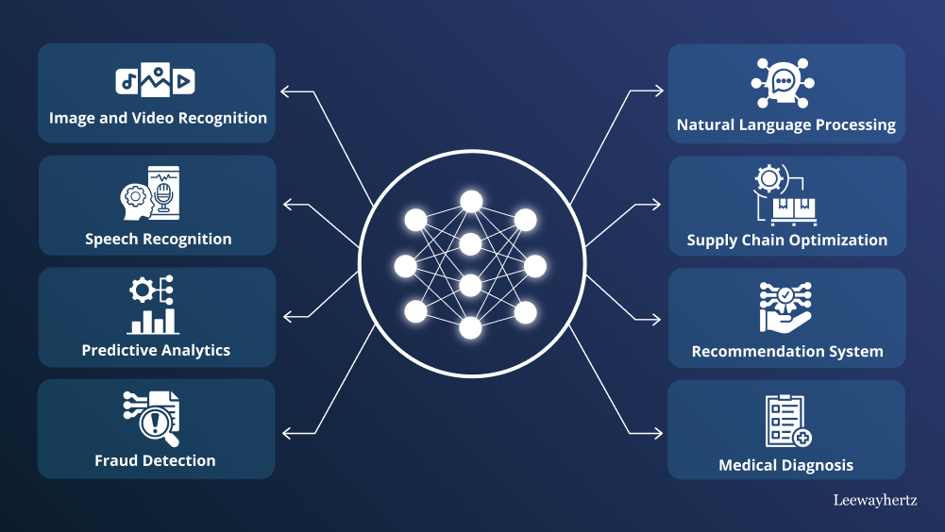
Big Picture –Applied Use Cases
References:
https://cloud.google.com/discover/ai-applications?hl=en
https://www.ibm.com/think/topics/artificial-intelligence-business-use-cases
https://www.leewayhertz.com/ai-use-cases-and-applications/

Slide 14
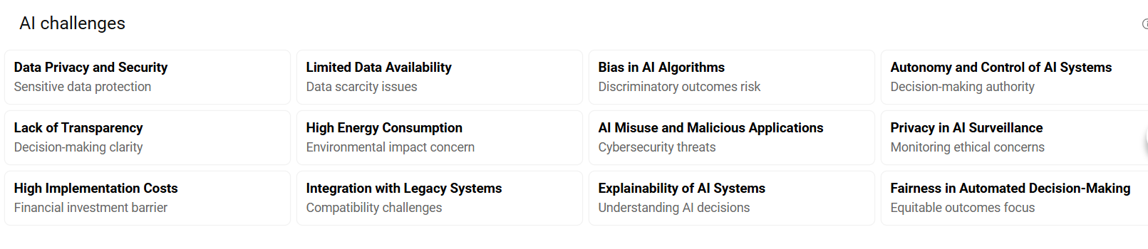
Challenges of AI
References:
https://www.simplilearn.com/challenges-of-artificial-intelligence-article
https://www.geeksforgeeks.org/top-challenges-for-artificial-intelligence/
https://www.upgrad.com/blog/top-challenges-in-artificial-intelligence/

Slide 15
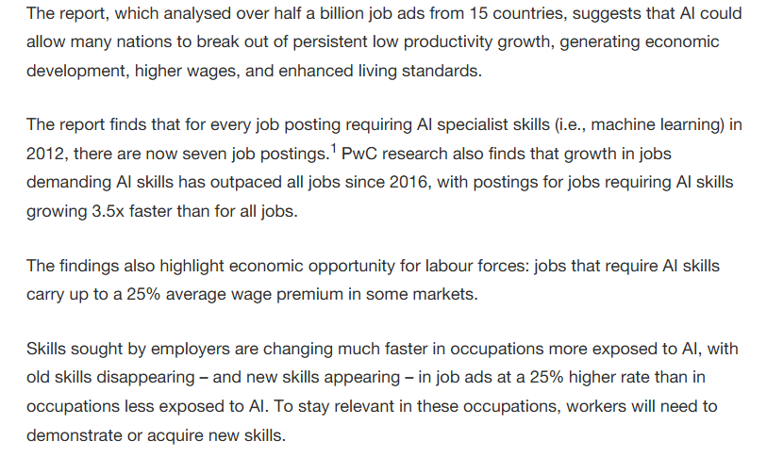
Your Professional Career – Why AI Important
References:
https://www.wgu.edu/blog/ai-careers-guide-jobs-artificial-intelligence2503.html
https://mitsloan.mit.edu/ideas-made-to-matter/why-future-ai-future-work
https://csuglobal.edu/blog/why-ai-important

Slide 16
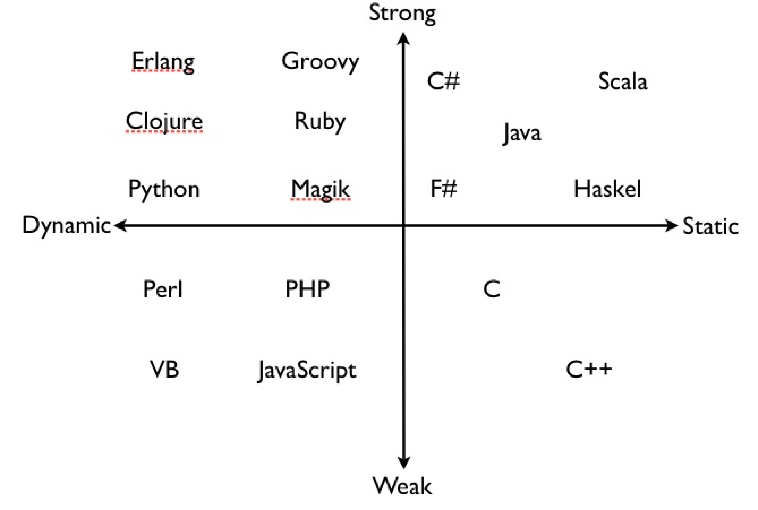
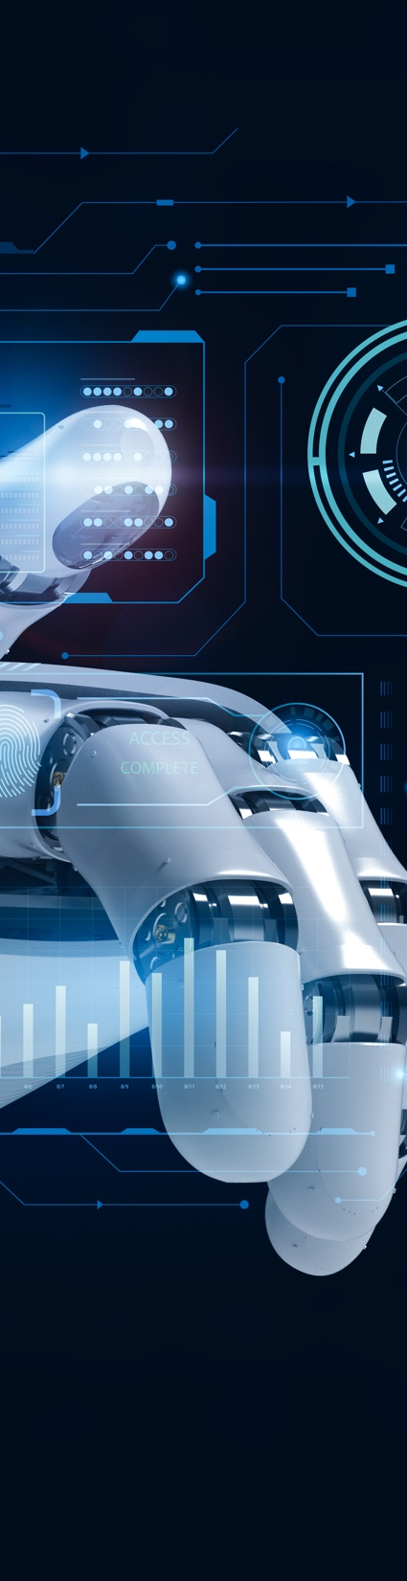
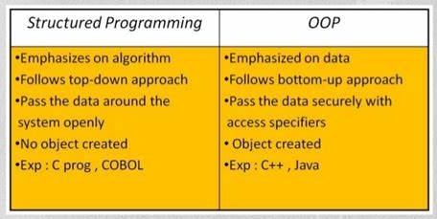
Development Background
Strongly typed vs weekly typed Programming languages
https://99x.io/europe/resources/blog/strongly-vs-weakly-typed-languages
https://www.linkedin.com/advice/0/what-difference-between-strongly-weakly-typed-eqwlc
https://medium.com/@fedor.selenskiy/static-dynamic-vs-strong-weak-typing-a-common-misconception-d050f24b7db9
Structured vs Object oriented - Programming Languages
https://www.geeksforgeeks.org/difference-between-structured-programming-and-object-oriented-programming/
https://dzone.com/articles/decoding-the-nuances-structured-vs-object-oriented
https://www.tutorialspoint.com/difference-between-structured-and-object-oriented-programming

Slide 17
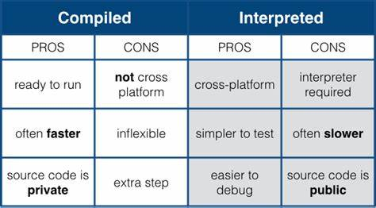
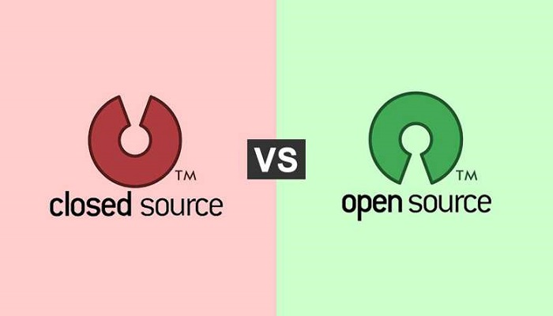
Development Background - 2
Compiled vs Interpreted Programming Languages
https://www.freecodecamp.org/news/compiled-versus-interpreted-languages/
https://www.geeksforgeeks.org/difference-between-compiled-and-interpreted-language/
https://byjus.com/gate/difference-between-compiled-and-interpreted-language/
Open Source vs Close source - Development / Culture
https://edu.gcfglobal.org/en/basic-computer-skills/open-source-vs-closed-source-software/1/
https://www.pingcap.com/article/open-source-vs-closed-source-software-benefits/
https://www.splunk.com/en_us/blog/learn/open-vs-closed-source-software.html
Open Source as business Strategy- example
Open Source – with custom build by each vendor. Foundation and its variant
M&A process – Company culture

Slide 18
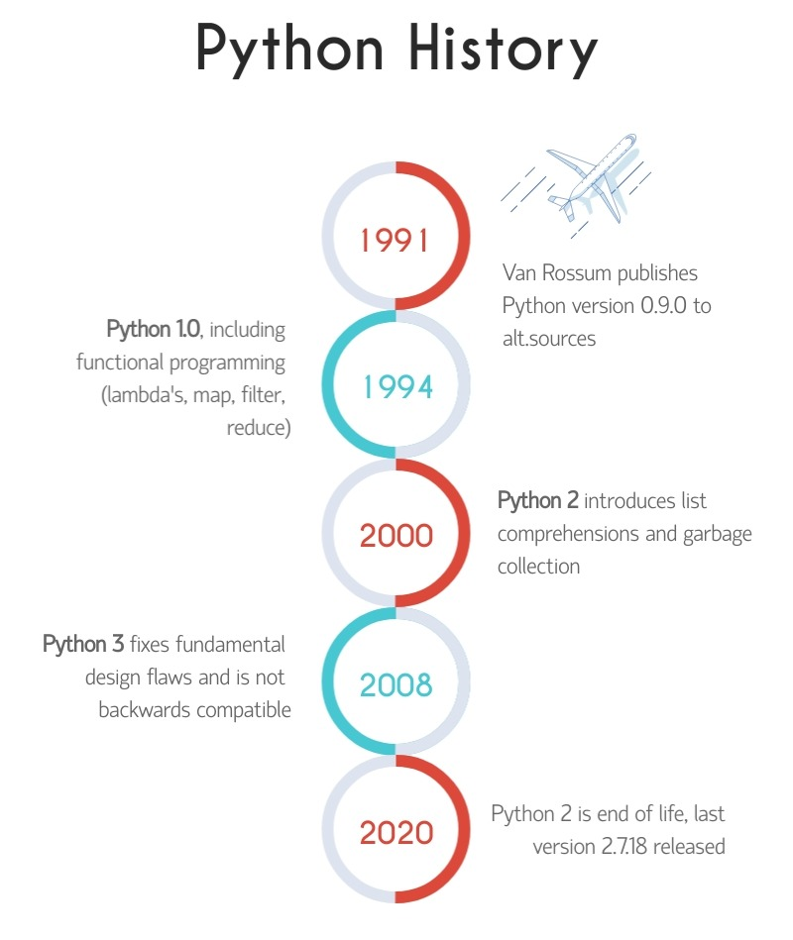
Development– The Python - Way
IDE: Visual Studio Code
IDE Extension: Python by Microsoft
Python version : 3.13.2
Source Code Repository : GitHub
Code Debugger: Build-in
System Requirements – how to find
Feature – Release notes
Known Issues
Using Google and LLMs
Resources:
https://wiki.python.org/moin/BeginnersGuide/Programmers

Slide 19
What is expected in this Course?
In-depth - Theoretical Foundation for AI / ML / DL
Python – deep dive as development platform – core development/programming stack
Development in NUMPY
Development in Pandas
Development in Seaborn
Development in Scikit-learn
Development in TensorFlow
Development in Keras
Machine Learning – Algorithm design, analysis , exploration, investigation and development
Deep Learning – Neutral Network - Algorithm design, analysis , exploration, investigation and development

Slide 20
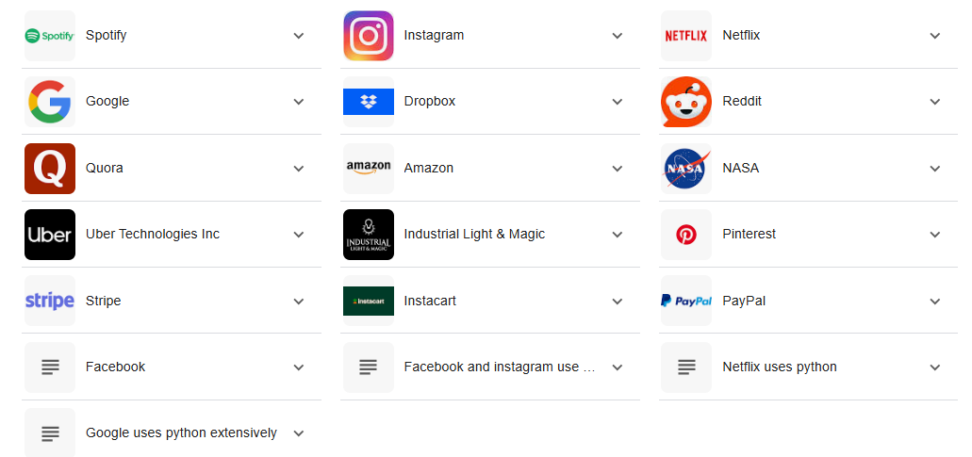
Which Global Companies Use Python?
References:
https://jaydevs.com/top-companies-that-use-python/
https://trio.dev/companies-using-python/
https://brainstation.io/career-guides/who-uses-python-today

Slide 21

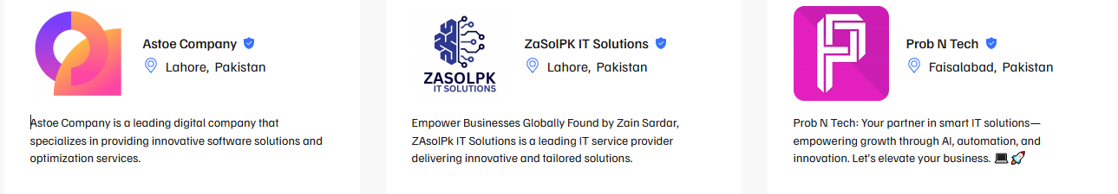
Which Software Houses in Pakistan- Use Python?
References:
https://techbehemoths.com/companies/python/pakistan
https://www.sortlist.com/s/python-development/pakistan-pk
https://superbcompanies.com/categories/python-development-companies-in-pakistan/
https://themanifest.com/pk/software-development/python-django/companies

Slide 22










Which Global Software Houses in Pakistan- Planning Big on AI?
https://systemsltd.com/services/generative-ai
https://systemsltd.com/services/advanced-analytics
https://www.xavor.com/ai-ml-solutions/
https://netsoltech.com/products/transcend-ai-labs
https://www.alphabold.com/solutions/artificial-intelligence/
https://arbisoft.com/solutions/data/generative-ai
https://arbisoft.com/solutions/data/deep-learning
https://arbisoft.com/solutions/data/machine-learning
https://arbisoft.com/solutions/data/science
https://nextbridge.com/ai-machine-learning/
https://nextbridge.com/computer-vision/
https://www.techlogix.com/data-analytics-ai/
https://northbaysolutions.com/services/generative-ai-ml/
https://www.afiniti.com/products/experienceai/

Slide 23
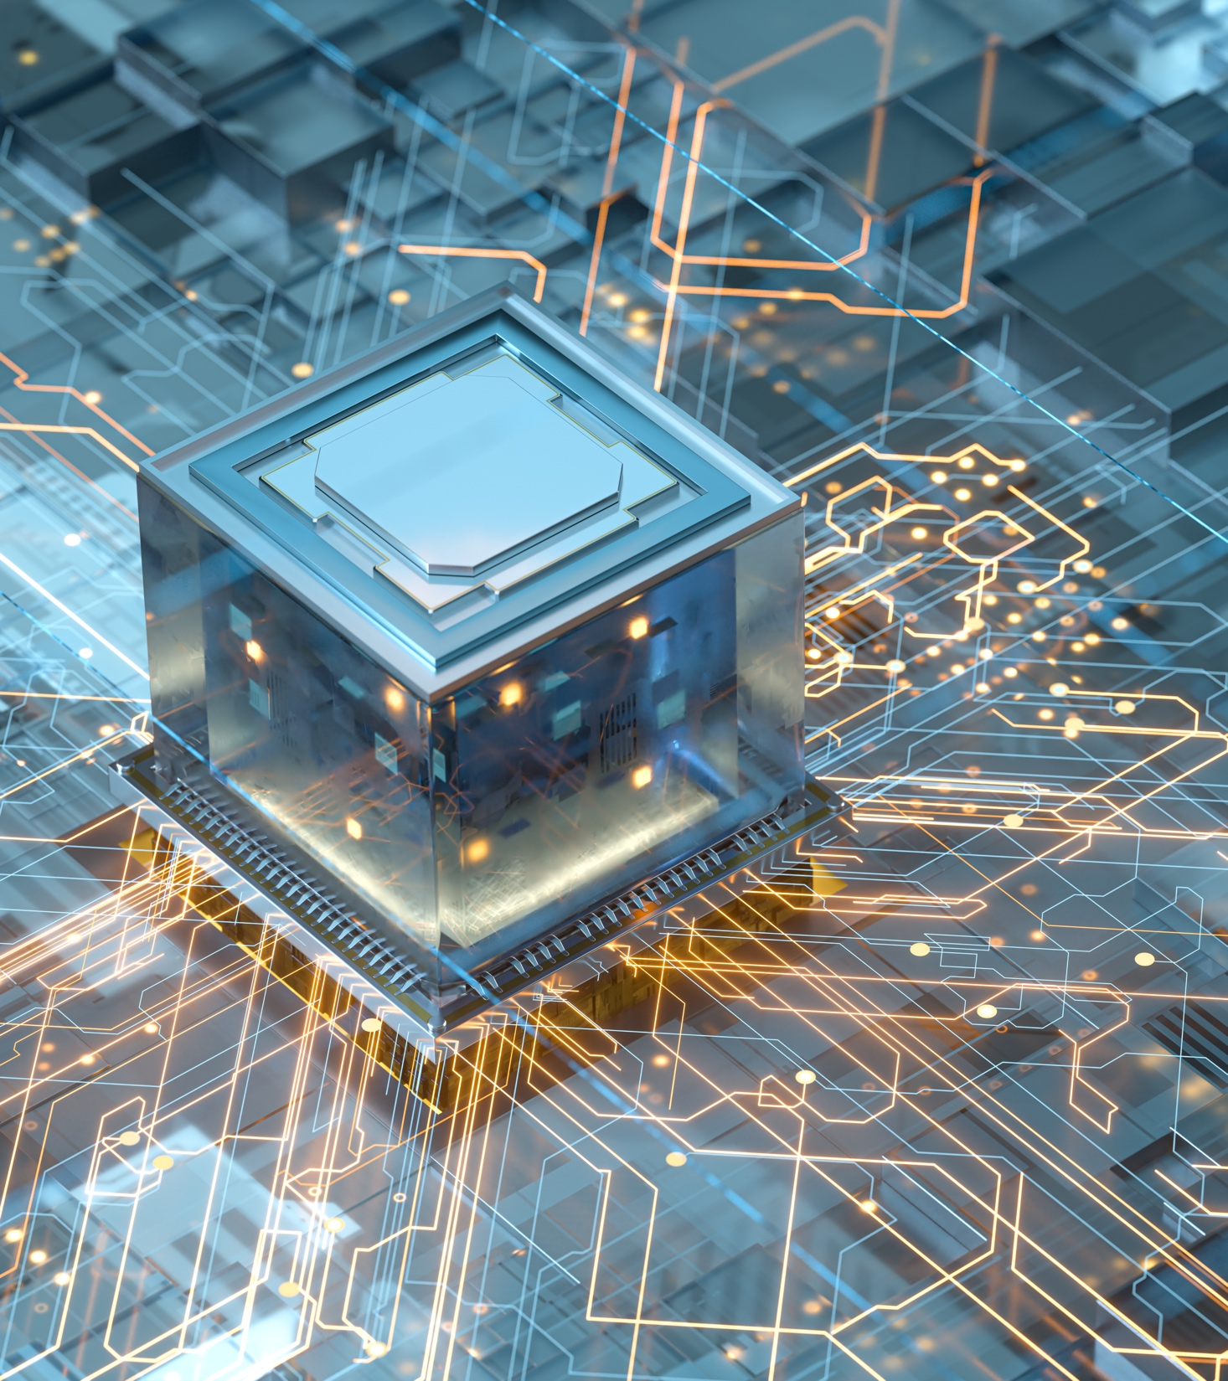
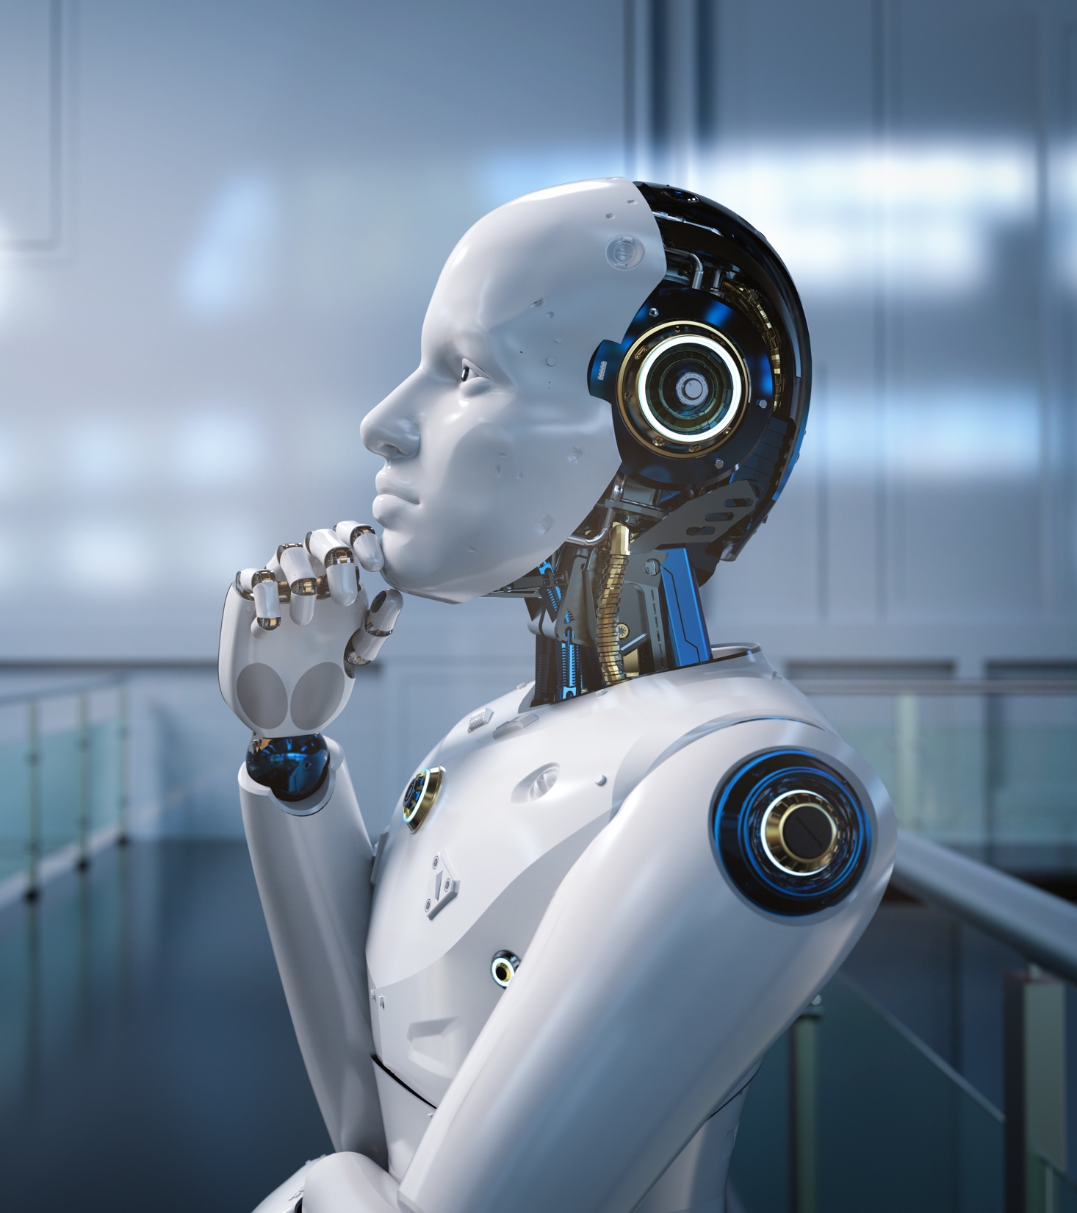
Shahzad Sarwar
Cognitive Convergence
https://cognitiveconvergence.com
Thank you - for listening
and participating
Questions / Queries
Suggestions/Recommendation
Ideas…..?
Movies about AI-Artificial Intelligence -Robots
https://www.imdb.com/list/ls500056453/
https://en.wikipedia.org/wiki/List_of_artificial_intelligence_films
https://www.top5.com/20-movies-about-artificial-intelligence-taking-over-the-world/
https://www.ranker.com/list/best-artificial-intelligence-movies-list/ranker-film

